Slide 1

Adaptive Employment Readiness Platform Using Real-Time Industry Skill Demand Mapping
CSA0925- Programming in Java
Guided By :Dr. Sivasankar C
Department:CSE
Presented By:
PAPINENI SISINDRI(192324122)
Nithish Raaju V
Pavithran M

Slide 2


SLIDE 1 – REVIEW-1 FEEDBACK
Feedback Received | Corrective Actions
Clearly explain how industry skill requirements are collected | Defined the Industry Demand Scraping Module for collecting job-posting data and extracting required skills
Explain how student skills are compared with industry requirements | Added a clear Skill Gap Mapping process to compare student skills with industry-demanded skills
Provide a clear flow between the three modules | Refined the architecture into a sequential flow: Industry Demand → Skill Gap → Adaptive Learning Path
Explain how students provide their skill information | Added Resume Upload / Student Profile as the input for skill identification
Provide personalized recommendations instead of generic suggestions | Designed the Adaptive Learning Path Module to generate recommendations based on identified skill gaps
Clarify the technologies and implementation approach | Defined the Java-based implementation using Java, Spring Boot, MySQL, and supporting libraries

Slide 3
SLIDE 2 – UPDATED ARCHITECTURE
Changes Made
Added Student Resume/Profile as the input source.
Defined the Industry Demand D aata Collection process.
Added Skill Extraction and Processing.
Connected industry skill demand with student skill analysis.
Added Skill Gap Report and Employment Readiness Score.
Added Personalized Adaptive Learning Path.
Defined database interaction between modules.

Slide 4
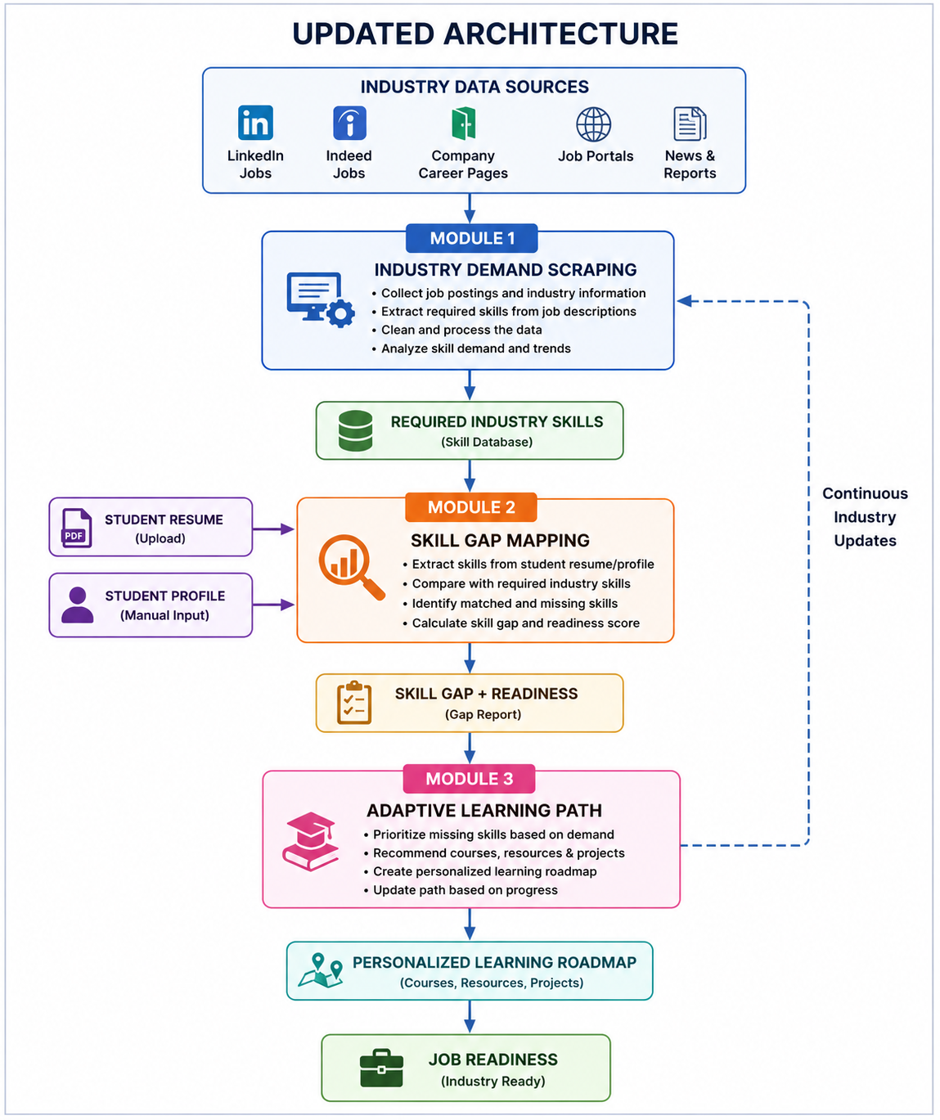
Final Module Flow

Slide 5
Module 1: Industry Demand Scraping Module
Purpose
Collect current job-market information.
Identify skills required by companies.
Analyze frequently demanded/trending skills.
Input
Industry job postings / job-market data
Processing
Data collection → Cleaning → Skill extraction → Demand analysis
Output
Required Industry Skills

Slide 6
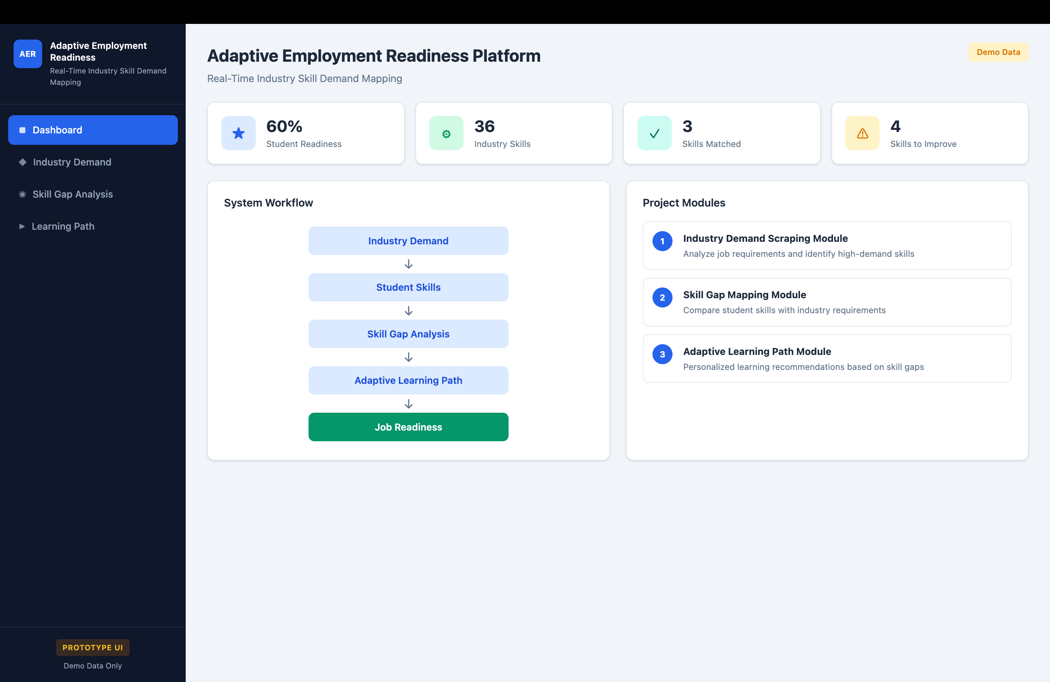

Slide 7
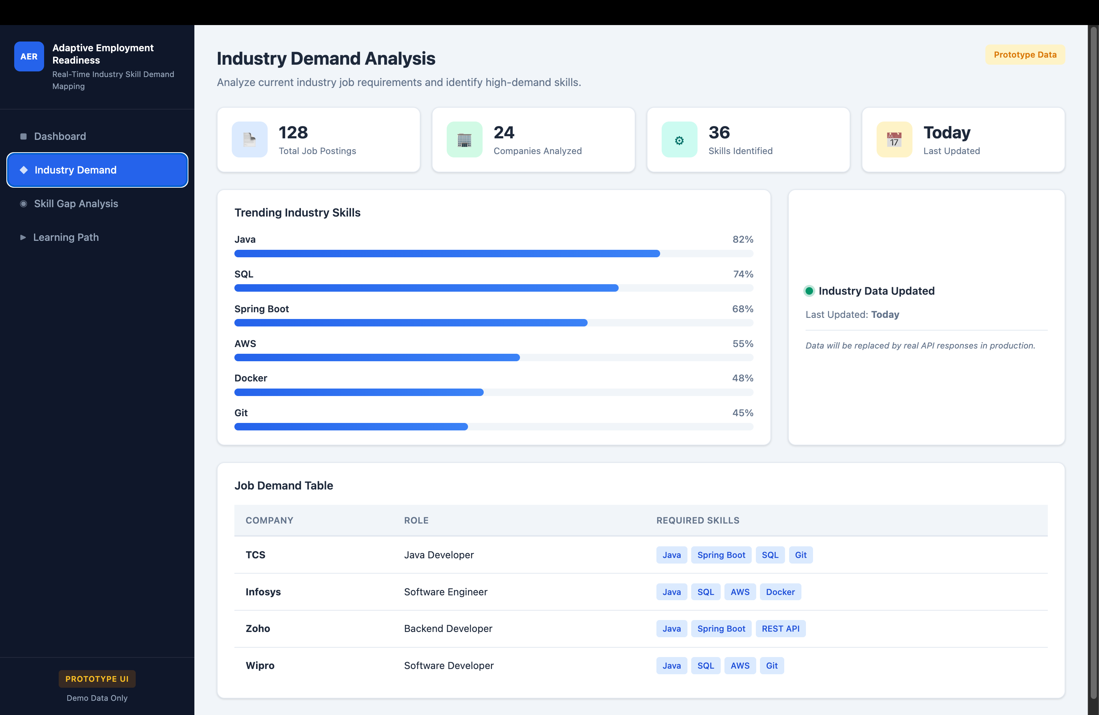

Slide 8
Module 2: Skill Gap Mapping Module
Purpose
Analyze the student’s existing skills.
Compare student skills with industry requirements.
Identify missing or weak skills.
Input
Student Resume
Student Profile
Required Industry Skills
Processing
Skill extraction → Skill comparison → Gap identification → Readiness calculation
Output
Skill Gap Report + Employment Readiness Score

Slide 9
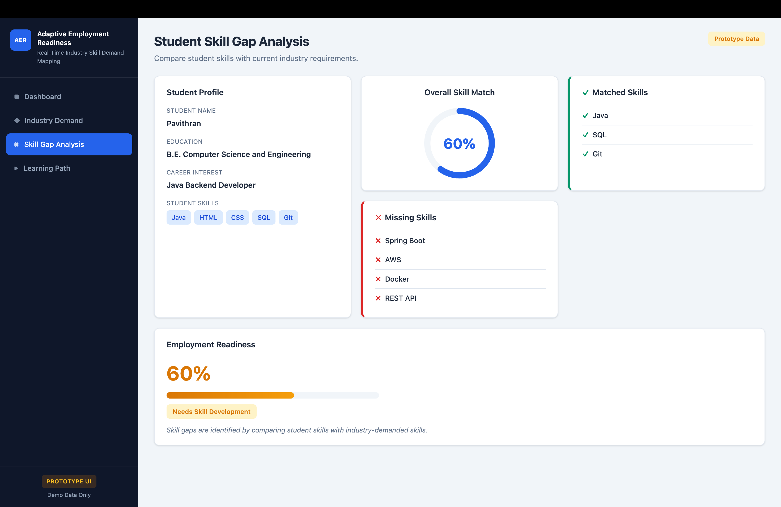

Slide 10
Module 3: Adaptive Learning Path Module
Purpose
Convert skill gaps into learning recommendations.
Prioritize skills according to industry demand.
Create a personalized learning roadmap.
Input
Skill Gap Report + Career Goals
Processing
Skill prioritization → Course/resource mapping → Learning-path generation
Output
Personalized Learning Roadmap

Slide 11
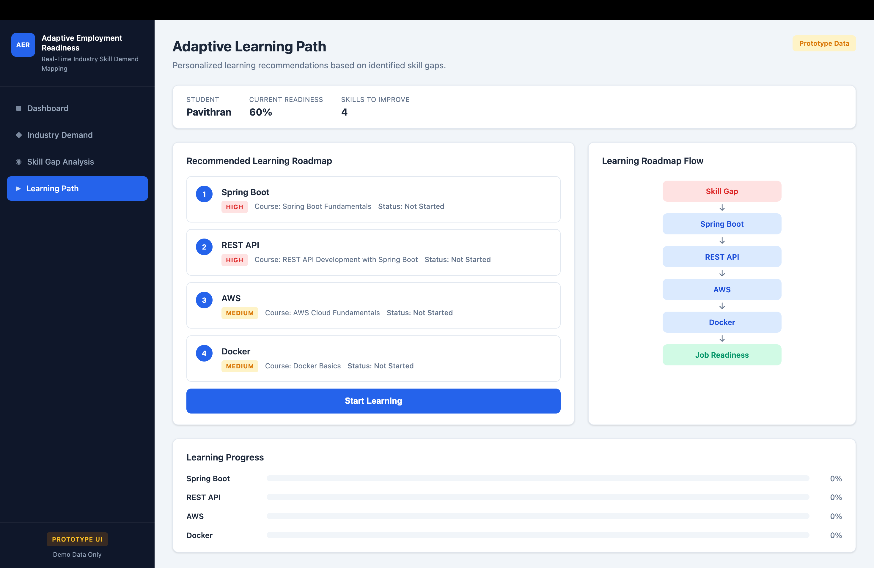

Slide 12
Slide 6 – Implementation
Implementation Progress
Developed Java/Spring Boot backend
Implemented 3 core modules
Added Resume/Profile input
Implemented Industry Skill Extraction
Developed Skill Gap Analysis
Added Readiness Score Calculation
Implemented Personalized Learning Recommendations
Integrated MySQL Database

Slide 13
Slide 7 – User Interface
User Interface Screens
Student Registration/Login
Student Profile Dashboard
Resume Upload
Industry Skill Demand Dashboard
Skill Gap Analysis
Employment Readiness Score
Personalized Learning Path
Learning Progress Tracking
Main UI Flow
Login → Upload Resume → View Skills → Skill Gap → Readiness Score → Learning Path

Slide 14
Slide 8 – Testing
Testing Approach
Unit Testing – Tested individual module functions.
Integration Testing – Tested communication between the three modules.
Database Testing – Verified data insertion, retrieval, and updates.
Input Validation Testing – Tested invalid/incomplete student information and resume uploads.
Functional Testing – Verified complete workflows from input to recommendation.
UI Testing – Checked navigation, forms, and dashboard functionality.

Slide 15
Slide 9 – Challenges
Challenges Faced
Industry Data Collection – Job portals have different formats and data structures.
Real-Time Data Availability – Maintaining regularly updated industry skill information.
Resume Parsing – Different resumes have different formats and structures.
Skill Extraction – Identifying technical skills accurately from unstructured text.
Skill Matching – Handling different names for similar skills, such as JavaScript and JS.
Recommendation Accuracy – Mapping identified skill gaps to suitable learning resources.
Database Integration – Maintaining consistent data between modules.
System Integration – Connecting all three modules into one complete workflow.

Slide 16
Thank You

